Slide 1
Bella Loves Me
The future of customer relations

Slide 2
Activity
Two truths and a lie!
This game is to get to know us, so you will first start your name and then 3 facts about yourself, one of these facts have to be false (or all true), the point is the other person has to say which of the statements was true and which was a lie.

Slide 3
Introduction
Tips for Customer Service
Conversational Banking
And doing the best to create a fantastic experience.
The Concierge Experience
Conclusion
Bella loves me
Bella focuses on Love and Kindness, we are all now a family

Slide 4
Activity
Share a rude, demanding or vague statement a customer would say based off situations that have happened to you before.
What do you think caused this? What could be the background story to the customer being so upset?
The idea here is to explain why the customer may have become difficult, for example maybe the difficult customer had had a bad day or a subpar experience.

Slide 5
Conversational Banking
Intro.
Conversational banking means the inclusion of messaging apps – with all their native abilities to communicate in text, voice and rich formats – into a bank’s client experience.

Slide 6
Conversational Banking
The future of Banking
Banks are looking to include the messaging apps and their abilities for communicate in text, voice and other formats to the banking experience. The goal is to have a natural language that will allow the managers and clients to have more effective conversations.

Slide 7
Conversational
With the conversational style service, AI-powered chatbots have to jump in and answer the bulk of repetitive questions. This will free up human agents for non-standard requests.
Banking
In other words, requests that used to be a self-service task for the client, become part of a natural conversation with the Al-powered chatbot or with the Al-supported human.

Slide 8
We want to make sure that we end with the communicational barriers that have been in the banking service by engaging in a quick conversation with the AI or a representative, making members comfortable by using the same platforms they are used to.
What Role do we play?

Slide 9
Understanding the needs and wants of Members to the core.
Why Bella Love works
Brand Love
Apple was able to position its products to cater to the functional and emotional preferences if its customers.
Business struggle to maintain clients when they fail to position their product according to the preferences of their target market. You can hire the most well trained and polite staff to address customers, but if your customer’s wants are not fulfilled, it is unlikely that they will love the brand.
Focusing on LOVE
We have to show genuine interest in our members' needs and be persistent in delivering value.

Slide 10
Concierge
Is the new agent
Spread the word

Slide 11
H.E.A.R.D
Disney handles over 135 million customers in their parks each year, they don't take customer service lightly. So, the technique Disney has developed to train customer service representatives in how to handle angry customers is called HEARD.
Hear: Listen to the customers entire story
Emphasize: Use phrases that convey that you understand how the member feels
Apologize: And do so effusively!
Resolve: Fix the issue, and if you don't know how to, ask the member "how can I set this right?"
Diagnose: Get to the bottom of the issue so you can make sure it won't happen again.

Slide 12
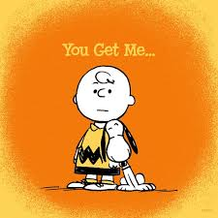
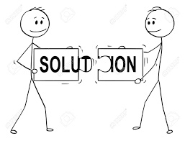
Activity
Let’s use the H.E.A.R.D. method!
Scenario 1: Client purchased a brand new smartphone and he is very upset because he ran over the phone with a truck and the warranty doesn’t cover it. 1 person has to be the extremely upset client and the other person has to be the agent using the method.
Scenario 2: You are the restaurant owner and someone parked their car underneath a palm tree, the building has a sign saying that you aren’t responsible for any damage of the car, and the majority of insurance companies don’t cover accidents caused by nature, etc. the tree fell on top of the vehicle and smashed it. Client is very upset.

Slide 13
Making friends
If you attended a party where the host snarled at you, reluctantly offered you a drink, looked past you to greet someone deemed more important and basically couldn't wait until you left -- chances are you would leave, slamming the door behind you.
We want our members to feel our love and that we are their friends, we are here for them and we’ll do our best to attend to any need they might have.

Slide 14
““Build a great experience, customers tell each other about that. Word of mouth is very powerful."
JEFF BEZOS
CEO, AMAZON

Slide 15
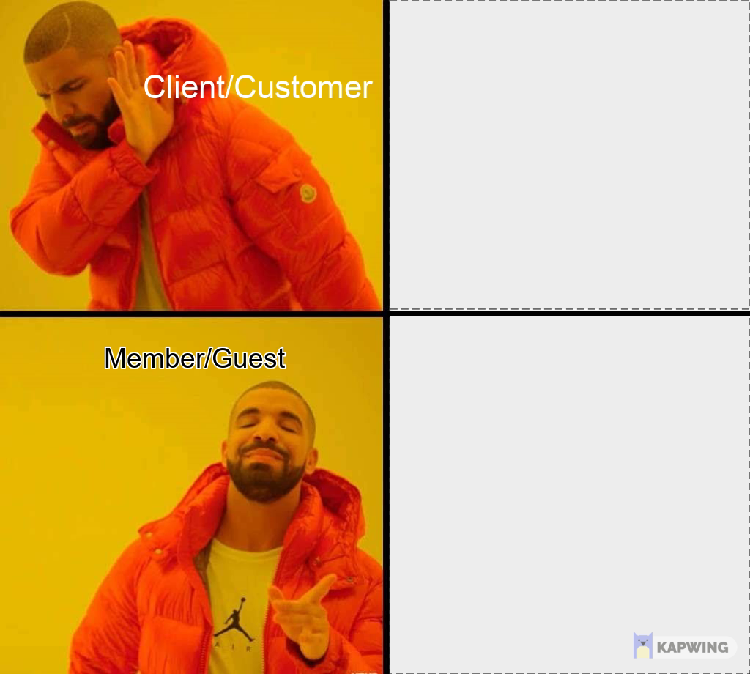
Concierge, not an agent
We should be always happy to hear from them and we strive to make their time with each of us a great experience.

Slide 16
Treat everyone like a VIP. “There's only one boss, the member,” “He can fire everybody from the chairman on down simply by spending his money elsewhere.”
Show immediate action and solutions, not blame. Sometimes things get messed up, but apologies, which matter, mean nothing if they aren't followed by action. Well done is better than well said.
Anticipating Needs

Slide 17
Why the concierge approach?
A concierge will welcome you and will cater to every need making sure that all issues are fixed, will anticipate guest’s needs, and the treatment will be compared to the warmth welcome you’ll give a family member visiting.

Slide 18
Maintaining a Positive Attitude
Attitude is everything, and a positive attitude goes a long way in providing excellent customer service. “The right attitude changes negative members’ experiences into positive members’ experiences, "Since most guests interactions are not face-to-face, your attitude should be reflected in your language and written tone (yes, that’s possible). It’s easy to misinterpret the tone of written communication, and email or live chat can come across as cold. Don’t be afraid to use emojis to convey warmth and good humor when appropriate,.

Slide 19
Activity
What was the most difficult experience you had with a customer? How did you solve it?
It may not even be necessarily your own story, you can also share something you witnessed.
How could have you done it better?

Slide 20
Creative Problem Solving
Over 80% of customers have churned because they experienced bad customer service.
Zappos once sent a best man free shoes the night before the wedding after his order was sent to the wrong location due to a mistake by the delivery company. Zappos solved a problem and exemplified excellent customer service — they won a customer for life and gave the man a story that he couldn’t wait to share. Don’t be afraid to wow your guests as you seek to problem-solve for them. You could just fix the issue and be on your way, but by creatively meeting their needs in ways that go above and beyond, you’ll create members that are committed to you and your product.

Slide 21
Respond Quickly
66% of people believe that valuing their time is the most important thing in any online customer experience. Resolving our members’ queries as quickly as possible is a cornerstone of good customer service.
Guests understand that more complex queries take time to resolve. There’s a difference between the time it takes you to respond and the speed at which you resolve their problems.

Slide 22
Let’s make this personal.
40% of customers say they want better human service. That means they want to feel like more than just a ticket number. They get angry when they’re not being treated like an individual person.
Who are you?
What do you like?
When’s your birthday?
What are your hobbies?
How are you feeling today?

Slide 23
Help members help themselves
Among consumers, 81% attempt to take care of matters themselves before reaching out to a live representative. Further research shows that 71% want the ability to solve most customer service issues on their own.

Slide 24
What makes a Concierge different than an agent?
Willingness
Commitment
Readiness to Take Action.
Make it personal.
Master Collaboration.

Slide 25
Tips for Excellent Customer Service

Slide 26
Activity
Mystery Item!
You have 2 minutes to come up with a 5 minute sales pitch about for a mystery item! The purpose of this is to know just how well you are able to handle yourself with the unknown and how good your communication skills are!
After your pitch, we will all vote to see if we are sold or not!

Slide 27
Customer Service Tips
No matter how awesome the product is, or how talented you think the team is, what our guests are most likely to remember is the direct contact they have with the company.

Slide 28
Practice Empathy, Patience, and Consistency
Good Customer Service is a Continuous Learning Process
Every member is unique and every support situation is different. Strive to have a deep understanding of your guests’ challenges and continue to search for better ways to address them.
Some of your guests will be full of questions, some just chatty, and others plain mad. You must be prepared to empathize guests and handle all of them and provide the same level of service every time.

Slide 29
Ask Members if They Understand
Make sure your members know exactly what you mean. Use positive language, stay cheerful no matter what, and never end a conversation without confirming the guest understands and is satisfied.
25% off or 25% more?

Slide 30
Show Your Members Your Work Ethic
You have to stay focused on your goals to achieve the right balance between members that would like for you to stay until their problem is solved and other members that are waiting for you.
If the situation was escalated, educate the member on the ETR and close the conversation.

Slide 31
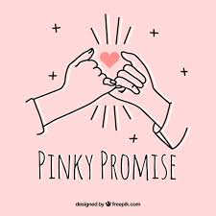
Don’t Be Afraid to Say “I Don’t Know”
You have to have thick skin
It’s your job to stay informed enough to respond to questions or at least know where to turn if you don’t remember. Members will appreciate your honesty and your efforts to find the right answer.
If a guest is completely unreasonable, just be human and level with them. Let them know you’re doing your best.
“I don’t know but I’ll find out”

Slide 32
Make sure you have a full view of your guest’s experience, or you risk breakdowns in service that will hurt business. If you discover a lapse in service, make sure to bring it up with your management team so it can be fixed.
Pay attention to your Guests’ experience

Slide 33
Show Members you’re human
See what you might have in common. By humanizing your relationship you’ll make resolving conflict easier, your members will like you more (and as a result, your business).

Slide 34
Practice Active Listening
When you use active listening, your guests feel heard. If something they mention doesn’t make sense to you, restate:
“To make sure we are on the same page, are you talking about ….?”

Slide 35
Use clear terms, make sure that your members are able to understand what you mean while using terms that are easy for the member to understand. Avoid sarcasm.
Practice clear communication

Slide 36
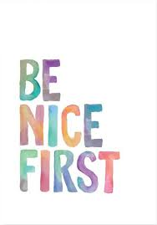
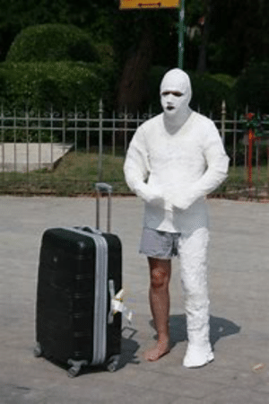
Don’t be stiff
When you speak or write to guests be personable, casual, and most importantly be friendly. Don’t treat members like a number by using an overly formal tone. If they make a joke, we can laugh.

Slide 37
Don’t use negative language
“I can’t get you an upgrade until next month. Our service is back-ordered and unavailable right now.”
Use Positive language
“That upgrade will be available next month. I can put in an order for you right now and make sure your account is upgraded as soon as it’s released!”

Slide 38
It’s important for customer service teams to stay consistent in the tone they use and the processes they practice. A great way to do both is to use the CARP method:
Control the situation.
Acknowledge the dilemma.
Refocus the conversation.
Problem-solve so the customer leaves happy.
Use the C.A.R.P. Method

Slide 39
Solve your guests’ problems the first time they call in. There’s nothing your members will appreciate more than getting their issues addressed the first time around.
Solve problems on the first call

Slide 40
Close conversations correctly
Use Customer Service Templates
Keep your response time low and avoid typos on basic and common questions.
Every conversation you close with a guest should end with you saying “Is there anything else I can do for you today? I’m happy to help!” and your guest saying “Yes, I’m all set!” loud and clear.

Slide 41
Activity
How to say no without saying no.
Imagine that you received a crazy request from a member. How would you react? Is it possible?
Create a scenario that you think would be impossible. How would you say no to the member without saying no? Share what you would say or do.

Slide 42
While we have given lots of examples of complimentary words and compliments, the key is to deliver them in the right way. They need to come across as authentic.
Complimentary words are those that we use in a conversation to make the person we are talking to feel good about themselves.
Complimentary words
These words can be particularly powerful in customer service and sales when looking to positively influence the emotions of a guest.

Slide 43
“I think that was a very wise decision to make.”
“I can see that you’ve been a loyal member, that’s really great!”
“Thanks for being so honest with me about how this is impacting you.”
“It’s good’s that you’ve shared that with me.”

Slide 44
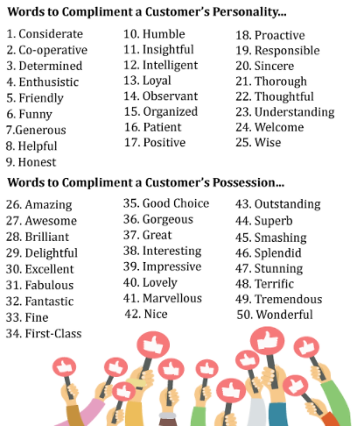
Activity
Compliments for clients!
Share your top 5 picks for compliments. Why are the your top 5? What do those compliments mean to you?

Slide 45
Go the extra mile
Can you remember a time that a business went above and beyond to ensure that you were a satisfied customer? How did that make you feel?
Always strive to make your customers feel that way on a daily basis.

Slide 46
Be honest with your guests at all times
Ideally, any business wants to deliver what they’ve promised without any complications or obstacles. Unfortunately, that cannot always be the case. However, keeping the lines of communication open and always being honest is key to providing an exemplary guest’s experience.
Be honest with the ETA/ETR.

Slide 47
Conclusion
Bella Loves Me

Slide 48
Conclusion
The United States is definitely a consumer culture, which means there are countless businesses selling vast amounts of products and services to a large population of people. With this much competition in the marketplace, having fantastic products and services is simply not enough to earn loyalty and repeat business. What companies must do is set themselves apart from their competitors, and one effective way to do this is through providing great customer service.

Slide 49
Conclusion
Customer service may be defined as the ability of an organization or company to tend to their guests’ needs and wants, and to meet – and even exceed – their guests’ expectations.

Slide 50
Meeting and Exceeding Expectations
Dig deep to find out how to meet and exceed the expectations for a solution. Remember, you are the expert in your field and members are coming to you expecting that their specific needs will be met and their problems resolved.
Make sure that all issues presented are solved 100%, even if that means educating the member on alternative options.

Slide 51
Remember!
There are six universal emotions – anger, disgust, fear, happiness, sadness, and surprise. All these emotions are responsible for determining daily decisions, so they are important when providing customer service with a memorable moment.
We don’t know if by you showing a positive attitude you can change a person’s day!

Slide 52
What abilities should we ALWAYS have?
Ability to Listen
Clear Communication
Positive and Friendly Attitude
Patience and Self-control
Understanding and Empathy
Assertiveness and Self-confidence

Slide 53
THANKS

